Slide 1
Where are the best areas for Students to live in Exeter, UK?

Slide 2
The Problem
Like many UK universities, first year students live in University Halls on campus.
Shortly after starting at university, students get into groups and start looking for houses for their second year.
This happens early due to houses coming onto the rental market in small batches, leading to the perception that there are not many properties to choose from.
It’s hard for students to know whether there will be houses with the right number of bedrooms available,
As they are new to the city they may not know which area would be best for them to look for student houses in.
As most are new to the city, they may not yet have found their favourite social venues either, or understand what transport links there are.

Slide 3
Data sources & cleaning
Information about Exeter’s postcodes and neighbourhoods (wards) was sourced from the internet.
A full list of houses registered as ‘Houses of Multiple Occupancy’ (HMOs) was scraped from the Exeter City Council website using Tabula-py.
Geographical information, specifically latitude and longitude data was retrieved using Geophy.
Foursquare API was used to retrieve information about different venues in the area.
The data was all cleaned and prepared, ready to use with Folium Maps .

Slide 4
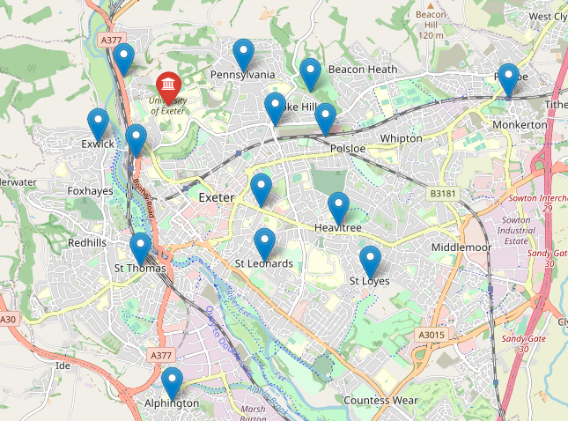
Exeter University Main Campus & the centre point of the local Neighbourhoods (wards)

Slide 5
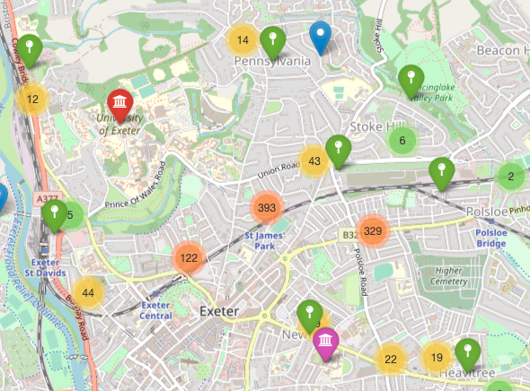
Clusters of student houses in Exeter

Slide 6
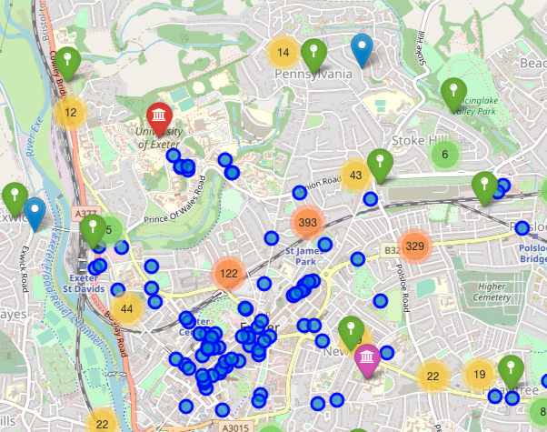
Venues (blue circles) in relation to the university and student house clusters

Slide 7
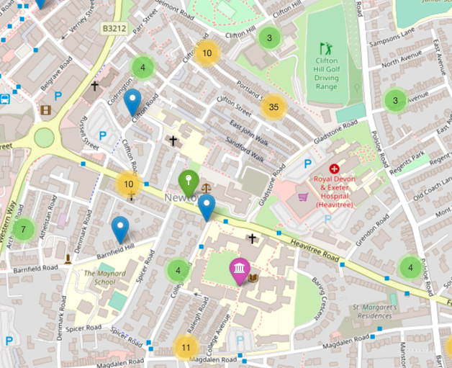
Student houses located near Exeter’s St Luke’s campus (primarily medical students)

Slide 8
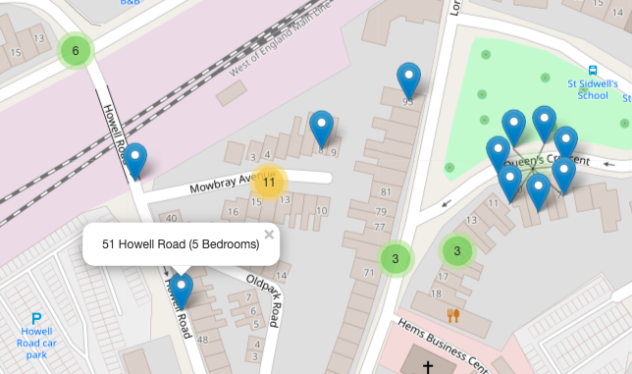
Zooming in shows the address, and number of bedrooms for each property

Slide 9
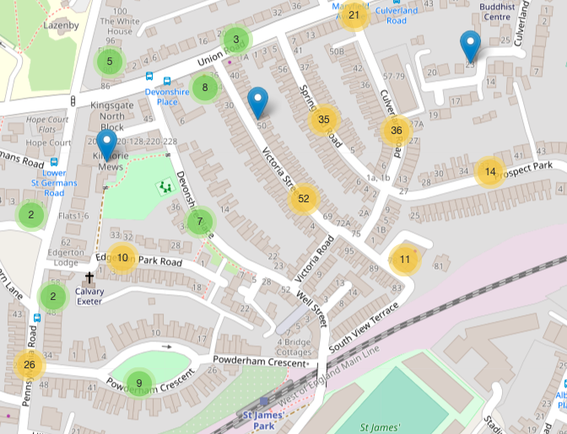
Some streets have a high proportion of student houses.

Slide 10
Conclusions
Most popular student area is to the South East of the main campus in the area of St James’s Park
Close to the university
Near to the city centre, and its wide variety of venues
Close to St James’s train station for connections to St David’s mainline, and the rest of the UK
Some streets have high proportion of student houses
Great for groups of social students wanting to live close to other groups of friends
Perhaps areas to avoid for families looking for quiet residential streets!
Visibility of the types of houses and where they are located would help students plan their house groups more effectively, ensuring that they choose the right area for them.
Newtown & Heavitree are good locations for students at the St Luke’s campus. There are not many venues here, but these tend to be medical students with less time for socialising compared to other students.

